Slide 1

Skill Court 5 Team Member(s): Sean Borland
Gajen Gunasegaram Product Owner(s):
Gudmundur Orn Traustason
Instructor: Masoud Sadjadi
School of Computing and Information Sciences Florida International University
Senior Project Final Presentation Summer 2016
August 5, 2016
Notes:
Greet your audience, thank them for attending your presentation, introduce yourself, introduce your project, introduce your team members, and quickly indicate what each of you did in a high-level manner, and put more emphasis on your part/contribution.

Slide 2
Project definition
Notes:
10 seconds.
Introduce the problem that the whole project (in all versions) tackles with GIF or screenshot.

Slide 3
Project definition
Notes:
20 seconds.
Introduce the problem that the your project (in new version) tackles with GIF or screenshot.

Slide 4
Requirements: Use Cases
Notes:
5 seconds
Show the Use Case Diagram for the whole project. Highlight your use cases.

Slide 5
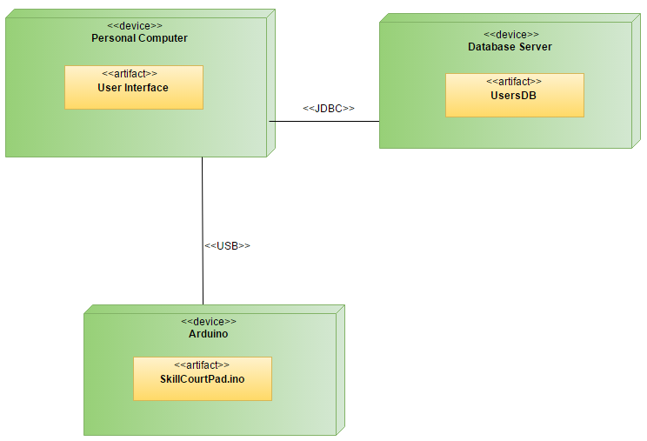
System Design: Architecture
Notes:
20 seconds
System design: Highlight the parts that you contributed to them.
1. System decomposition; identify the architecture patterns used
2. System deployment – h/w and s/w requirements

Slide 6
Minimal Class Diagram
Notes:
10 seconds.
Minimal class diagram. Highlight the classes that you created/modified
Identify the design patterns used (one or more slides).

Slide 7
User Stories
Pads change colors upon being hit.
2. Implement and Display a countdown game timer.
3. Start menu to select number of pads and game time.
4. Receive data from multiple pads.
5. Front-end login and Account Creation Interface.
Notes:
5 seconds.
List the user stories that you worked on them.(put in order of importance). Stay focused on the parts that you have been working.

Slide 8
User Story #1: Pads change colors upon being hit.
The pads won’t change to the next sequence until either a green or red pad has been hit.
The delay for communication between the pad and serial port has been reduced from 1000ms to 10ms.
Notes:
4. Requirements:
4.1. User stories implemented (one or more slides).
4.2. UML use cases and the use case diagram for the implemented use cases (one or more slides).
4.3. UML sequence diagrams for the implemented use cases.

Slide 9
User Story #2: Implement and display a countdown game timer.
In the previous version of the game, the player had no sense of the time remaining.
A running timer is now displayed on the scoreboard.
Notes:
4. Requirements:
4.1. User stories implemented (one or more slides).
4.2. UML use cases and the use case diagram for the implemented use cases (one or more slides).
4.3. UML sequence diagrams for the implemented use cases.

Slide 10
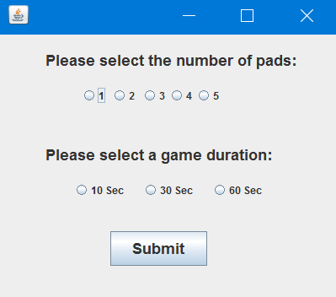
User Story #3: Start menu to select number of pad and game time.
Intuitive menu design.
Ability to select different number of pads and select a specific game duration.
User constraints preventing the player from inputting incorrect value or lack of values.
Notes:
4. Requirements:
4.1. User stories implemented (one or more slides).
4.2. UML use cases and the use case diagram for the implemented use cases (one or more slides).
4.3. UML sequence diagrams for the implemented use cases.

Slide 11
User Story #4: Receive data from multiple pads
The old code worked using exactly three pads.
First, the ability to receive from more than one pad was implemented.
Then the ability to have any number of pads from 1 to however many Arduinos the user has was implemented.
Notes:
4. Requirements:
4.1. User stories implemented (one or more slides).
4.2. UML use cases and the use case diagram for the implemented use cases (one or more slides).
4.3. UML sequence diagrams for the implemented use cases.

Slide 12
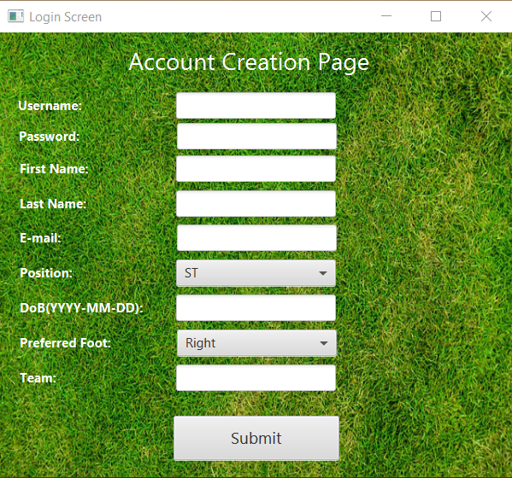
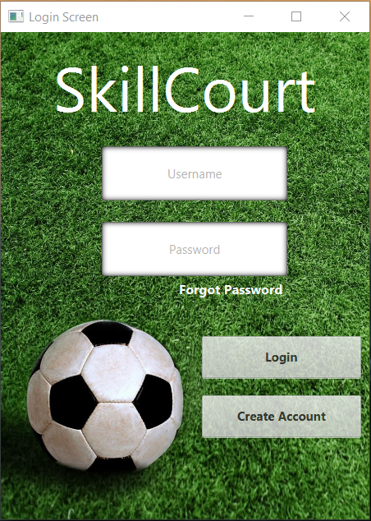
User Story #5: Front-end login and registration interface.
Users can now login and create personalized accounts.
Intuitive login and create account interface.
Sets up the ability for a user to store and view current and past results.
Notes:
4. Requirements:
4.1. User stories implemented (one or more slides).
4.2. UML use cases and the use case diagram for the implemented use cases (one or more slides).
4.3. UML sequence diagrams for the implemented use cases.

Slide 13
Test Case: Implement and display a countdown game timer (Sunny Day).
Test Case ID - CreateGame_001
Purpose:
To test that a game can be successfully started using the desired amount of pads and game duration
Precondition:
The Arduino code is uploaded to each Arduino
The Java code is running
Input:
Integer representing number of pads and game duration
Expected Output:
The system will display the scoreboard and begin the game after a brief time
Notes:
10 seconds
A description of verification process and Test Suites and Test Cases for one of the use cases.
1 One sunny day and one rainy day for the implemented use cases (one or more slides).
2 Automated test scripts for the implemented use cases (if any) (one or more slides).

Slide 14
Test Case: Implement and display a countdown game timer (Rainy Day).
Test Case ID - CreateGame_002
Purpose:
To test that the game will not start unless the timer and number of pads are selected
Precondition:
The Arduino code is uploaded to each Arduino
The Java code is running
Input:
The user does not select any values for number of pads and game duration, passing 0 as the int for the method call
Expected Output:
The JFrame will return an error message to select a number of pads and game duration
Notes:
10 seconds
A description of verification process and Test Suites and Test Cases for one of the use cases.
1 One sunny day and one rainy day for the implemented use cases (one or more slides).
2 Automated test scripts for the implemented use cases (if any) (one or more slides).

Slide 15



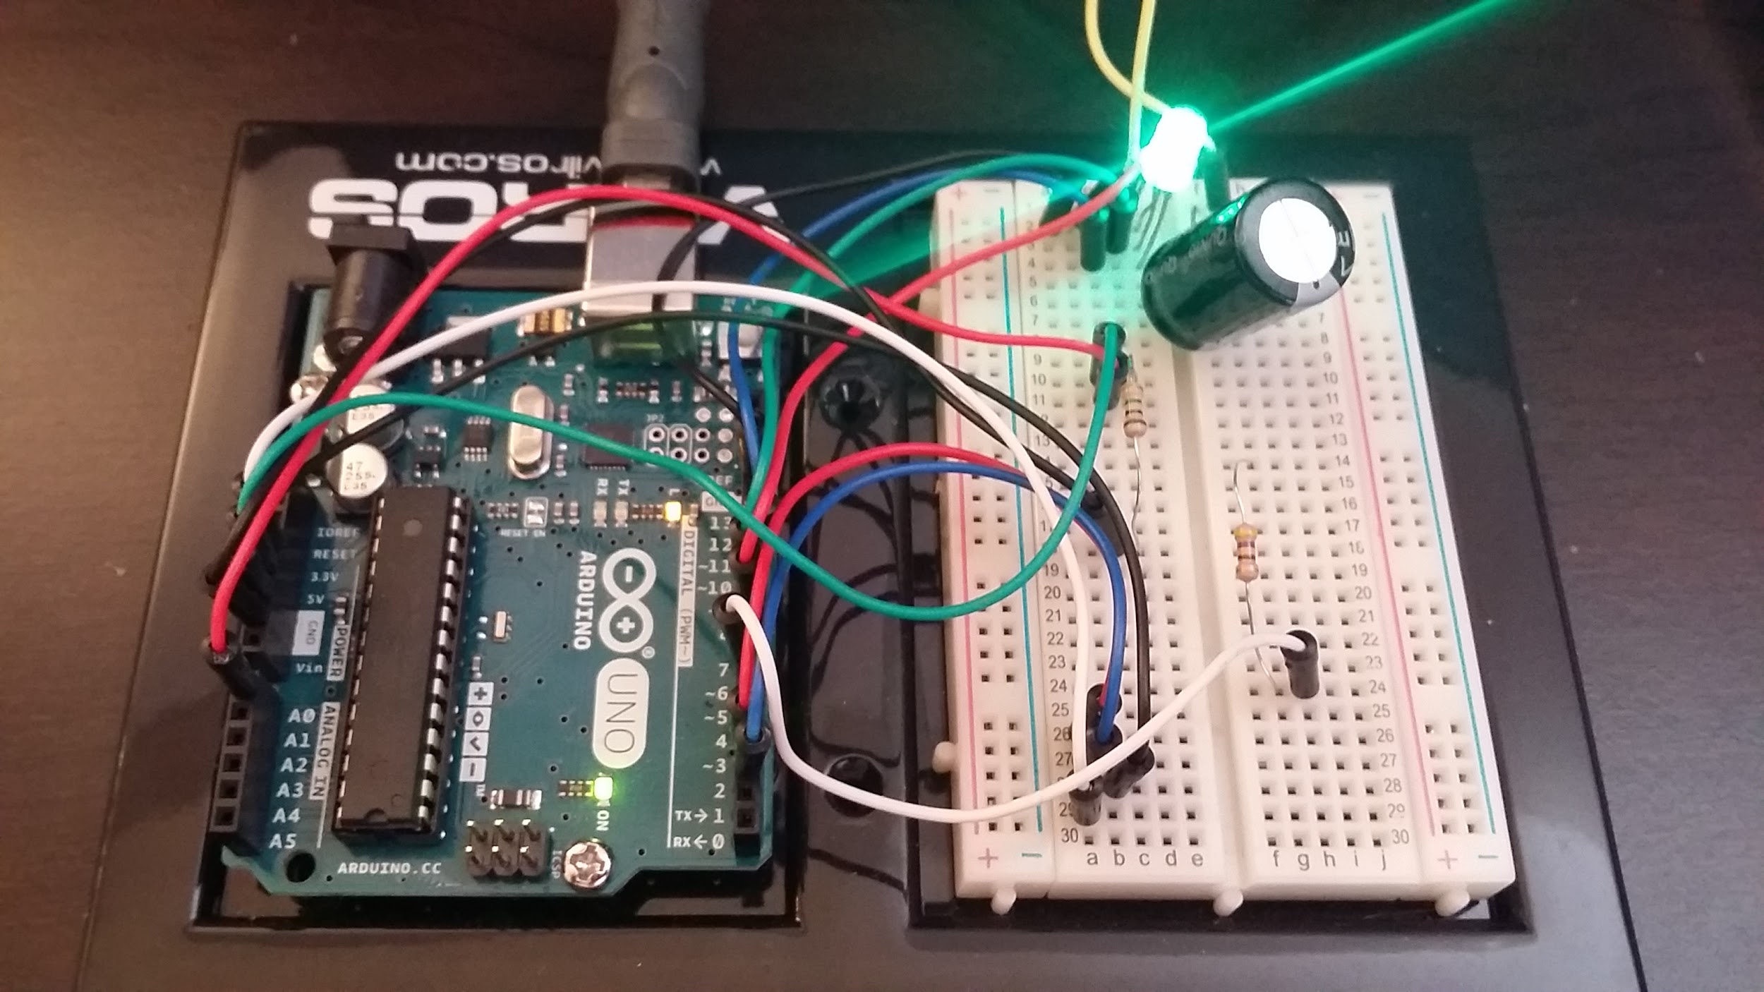

Summary
seanfborland@gmail.com
Questions?
Thank You!
Notes:
10 seconds
Summarize your contribution, mention your effort for Scrum, Mingle, Github, Google Drive Documentation and minutes
Include your contact information
Ask if anyone has any questions for you.
Thank your audience

